Slide 1
The Complete and Easy Guide to Configuring Your Specific Thermo NanoLC for Mass Spec Analysis
May 2013

Slide 2
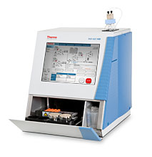
EASY-nLC 1000
Liquid Junction
LC
Source
HV junction
Direct Junction
Column setup
Pre-Col
+
Column
+
Emitter
Go to slide
Column
+
Emitter
Pre-Col
+
Column
+
Emitter
Packed Emitter
EASY-Spray
Pre-Col
+
EASY-Spray Column
Nanospray Flex
EASY-Spray Column
Slide 5
Slide 6
Pre-Col
+
Packed Emitter
Slide 8
Column
+
Emitter
Slide 9
Slide 10
Slide 11
Slide 12
Slide 7

Slide 3
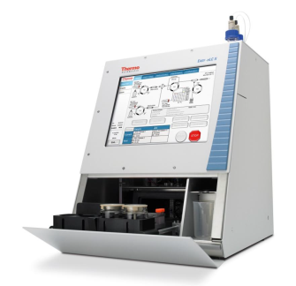
EASY-nLC II
Liquid Junction
LC
Source
HV junction
Direct Junction
Column setup
Pre-Col
+
Column
+
Emitter
Go to slide
Column
+
Emitter
Pre-Col
+
Column
+
Emitter
Pre-Col
+
Packed Emitter
Column
+
Emitter
Packed Emitter
EASY-Spray
Pre-Col
+
EASY-Spray Column
Nanospray Flex
EASY-Spray Column
Slide 13
Slide 14
Slide 15
Slide 16
Slide 17
Slide 18
Slide 19
Slide 20

Slide 4
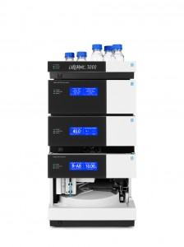
RSLCnano
Liquid Junction
LC
Source
HV junction
Direct Junction
Column setup
Go to slide
Pre-Col
+
Column
+
Emitter
Pre-Col
+
Packed Emitter
Packed Emitter
EASY-Spray
Pre-Col
+
EASY-Spray
Column
Nanospray Flex
EASY-Spray
Column
Slide 21
Slide 22
Go to slide
Heated
Slide 25
Slide 23
Room
Temp
Slide 24
Heated
Slide 26
Slide 27
Slide 28
Heated
Heated
Column
+
Emitter
Pre-Col
+
Column
+
Emitter
Room
Temp
Column
+
Emitter
Room
Temp
Room
Temp
Slide 29
Slide 30
Slide 31
Slide 32

Slide 5
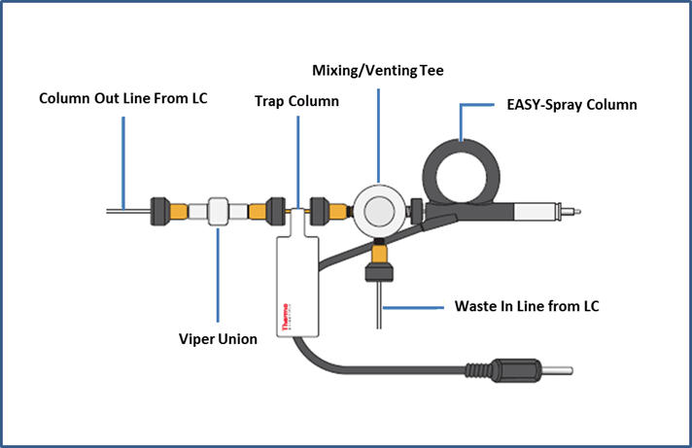
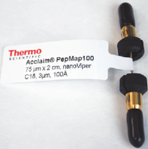


EASY-nLC 1000 with Precolumn and EASY-Spray Column
Consumables
Schematic
Item | Image | Part number
Viper Union |  | SC900
Acclaim Pepmap precolumn |  | 164705
A/B mixing & venting Tee |  | SC901
EASY-Spray column |  | Various: ES801 ES802 ES803

Slide 6
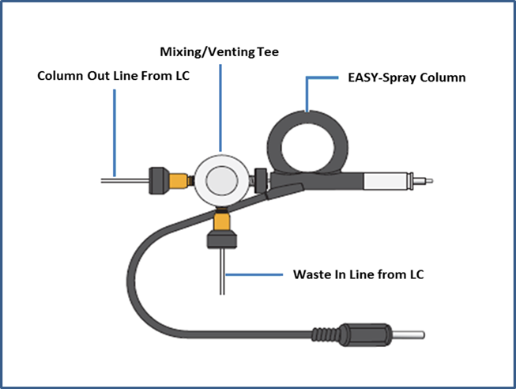
EASY-nLC 1000 with EASY-Spray Column
Schematic
Consumables
Item | Image | Part number
A/B mixing & venting Tee |  | SC901
EASY-Spray column |  | Various: ES801 ES802 ES803

Slide 7
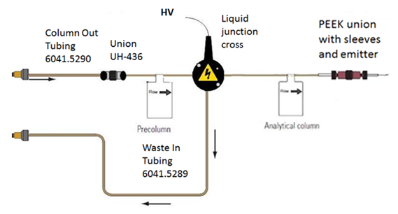

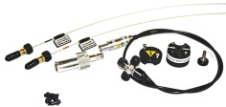
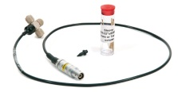
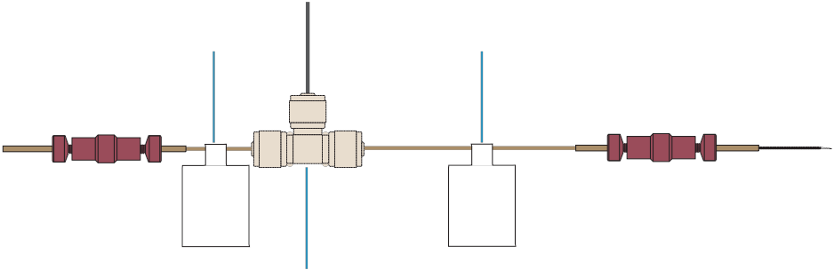

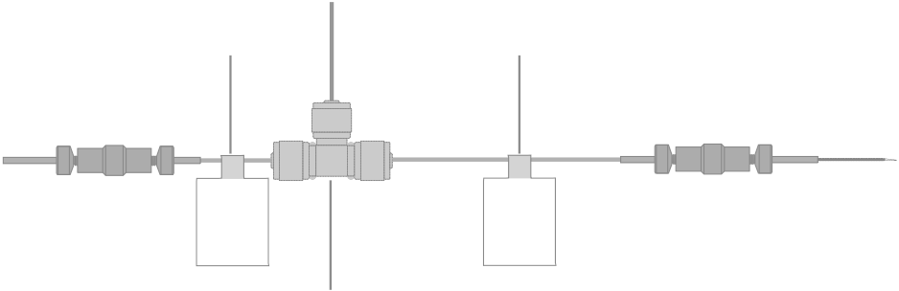

EASY-nLC 1000 with Liquid Junction, Precolumn, Analytical Column and Emitter
UHPLC Schematic--Preferred
Consumables
Item | Image | Part number
Column Out Tubing Waste In Tubing | Viper on LC side only Viper on LC side only | 6041.5290 6041.5289
Union For 360 µm OD |  | ES272
UPLC Liquid Junction Cross Kit |  | ES269
HPLC Liquid Junction Cross + Biege Sleeves |  | ES257
Red peek union for 1/32” OD |  | (IDEX) P-771
Sleeves for connecting OD 360 µm capillary to unions* | Beige (360µm x 1/32”)* | SC603*
Silica Emitter |  | FS360-20-10-N-20 (New Objective)
ES272
*
*
HPLC Schematic--300 bar max
Waste In Tubing
6041.5289
Column Out Tubing
6041.5290
Silica Emitter
*
Liquid Junction Cross
*
*
*
*
*
*
Pre-
Column
Analytical
Column
Peek
Union
Peek
Union
HV

Slide 8
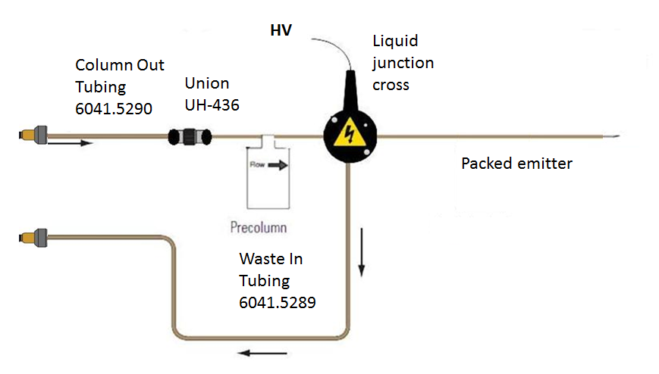
EASY-nLC 1000 with Liquid Junction, Precolumn, and Packed Emitter
UHPLC Schematic--Preferred
Consumables
Item | Image | Part number
Column out tubing Waste in tubing | Viper on LC Side Only Viper on LC Side Only | 6041.5290 6041.5289
Union For 360 µm OD |  | ES272
UPLC Liquid Junction Cross Kit |  | ES269
HPLC Liquid Junction Cross + Beige Sleeves |  | ES257
Red peek union for 1/32” OD |  | (IDEX) P-771
Sleeves for connecting OD 360 µm capillary to unions* | Beige (360µm x 1/32”)* | SC603*
ES272
HPLC Schematic--300 bar max
Waste In Tubing
6041.5289
Column Out Tubing
6041.5290
*
Liquid Junction Cross
*
*
*
*
Pre-
Column
Peek
Union
Packed
Emitter
HV

Slide 9
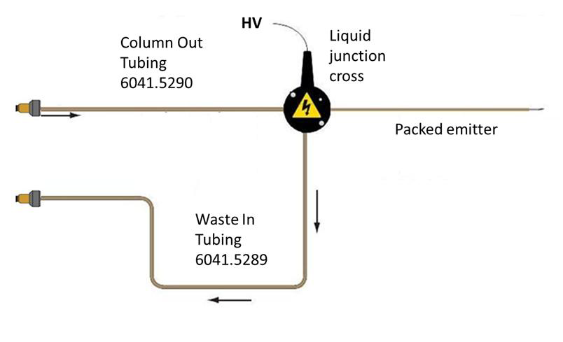
EASY-nLC 1000 with Liquid Junction, Analytical Column and Emitter
UHPLC Schematic--Preferred
Consumables
Item | Image | Part number
Column Out Tubing Waste In Tubing | Viper on LC side only Viper on LC side only | 6041.5290 6041.5289
UPLC Liquid Junction Cross Kit |  | ES269
HPLC Liquid Junction Cross + Beige Sleeves |  | ES257
Red peek union for 1/32” OD |  | (IDEX) P-771
Sleeves for connecting OD 360 µm capillary to unions* | Beige (360µm x 1/32”)* | SC603*
Silica Emitter |  | FS360-20-10-N-20 (New Objective)
*
*
HPLC Schematic--300 bar max
Waste In Tubing
6041.5289
Column Out Tubing
6041.5290
*
Liquid Junction Cross
Silica Emitter
*
*
*
*
Analytical
Column
Peek
Union
HV

Slide 10
EASY-nLC 1000 with Liquid Junction and Packed Emitter
UHPLC Schematic--Preferred
Consumables
Item | Image | Part number
Column out tubing Waste in tubing | Viper on LC Side Only Viper on LC Side Only | 6041.5290 6041.5289
UPLC Liquid Junction Cross Kit |  | ES269
HPLC Liquid Junction Cross + Beige Sleeves |  | ES257
Sleeves for connecting OD 360 µm capillary to unions* | Beige (360µm x 1/32”)* | SC603*
HPLC Schematic--300 bar max
Waste In Tubing
6041.5289
Column Out Tubing
6041.5290
*
Liquid Junction Cross
*
*
HV
Packed Emitter

Slide 11
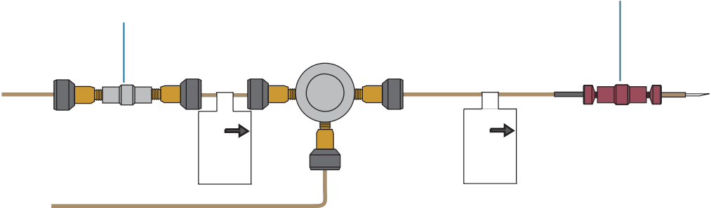



EASY-nLC 1000 with Direct Junction, Precolumn, Analytical Column and Emitter
Viper Column Schematic
Consumables
Viper
Union
Mixing/Venting
Tee
Peak Union
Item | Image | Part number
Viper Union |  | SC900
Mixing/ Venting Tee |  | SC901
Red peek union for 1/32” OD |  | (IDEX) P-771
Sleeves for connecting OD 280 µm capillary to unions | Black (280µm x 1/32”) | SC903
Metal Emitter |  | ES542
Column Out Tubing Waste In Tubing | Viper on LC side only Viper on LC side only | 6041.5290* 6041.5289*
Union for 360 µm OD |  | ES272
Ultra High Pressure MicroTee for 360 µm OD Tubing |  | (IDEX) UH-750
Sleeves for connecting OD 360 µm capillary to unions | Beige (360µm x 1/32”) | SC603
Black
Sleeve
Column Out
Line to LC
Pre-
Column
Analytical
Column
Metal
Emitter
Waste In Line from LC
Non-Viper Column Schematic
Waste In Tubing
6041.5289
Column Out Tubing
6041.5290
Beige
Sleeve
Metal Emitter
Venting
Tee
Pre-
Column
Analytical
Column
Peek
Union
Union for
360 µm OD
*For non-Viper Column Connections

Slide 12
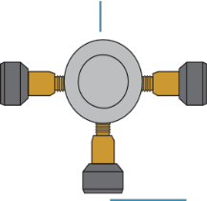

EASY-nLC 1000 with Direct Junction, Analytical Column and Emitter
Viper Column Schematic
Consumables
Mixing/Venting
Tee
Item | Image | Part number
Mixing/ Venting Tee |  | SC901
Red peek union for 1/32” OD |  | (IDEX) P-771
Sleeves for connecting OD 280 µm capillary to unions | Black (280µm x 1/32”) | SC903
Metal Emitter |  | ES542
Column Out Tubing Waste In Tubing | Viper on LC side only Viper on LC side only | 6041.5290* 6041.5289*
Ultra High Pressure MicroTee for 360 µm OD Tubing |  | (IDEX) UH750
Sleeves for connecting OD 360 µm capillary to unions | Beige (360µm x 1/32”) | SC603
Black
Sleeve
Column Out to LC
Analytical
Column
Peek
Union
Metal
Emitter
Non-Viper Column Schematic
Waste In Line from LC
Waste In Tubing
6041.5289
Column Out Tubing
6041.5290
Beige
Sleeve
Venting
Tee
Metal Emitter
Analytical
Column
Peek
Union
*For non-Viper Column Connections

Slide 13
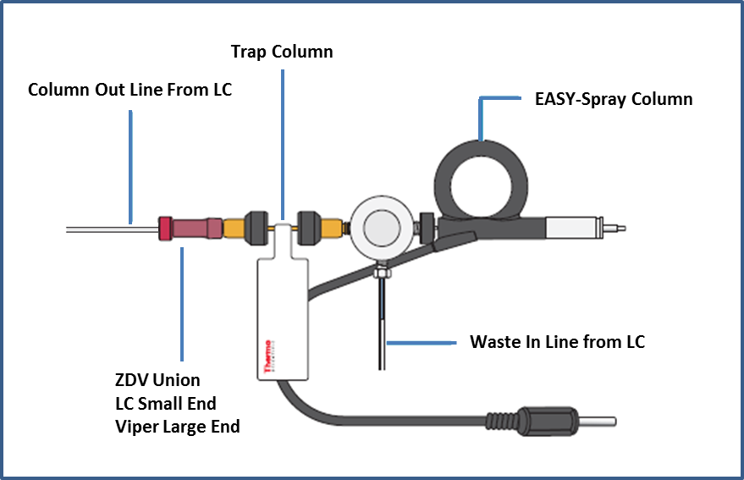


EASY-nLC II with Precolumn and EASY-Spray Column
Schematic
Consumables
Item | Image | Part number
Adapter Mictrotight 1/16” to 1/32”, peek |  | (IDEX) P-881
Acclaim Pepmap precolumn |  | 164705
A/B mixing & venting Tee |  | SC901
Acclaim PepMap 100 | Pre-Column | 164705
EASY-Spray column |  | ES800
Tubing Sleeve, 865 µm (0.034") ID x 1/16" OD, PEEK™, Blue |  | (IDEX) F233
Sleeve

Slide 14
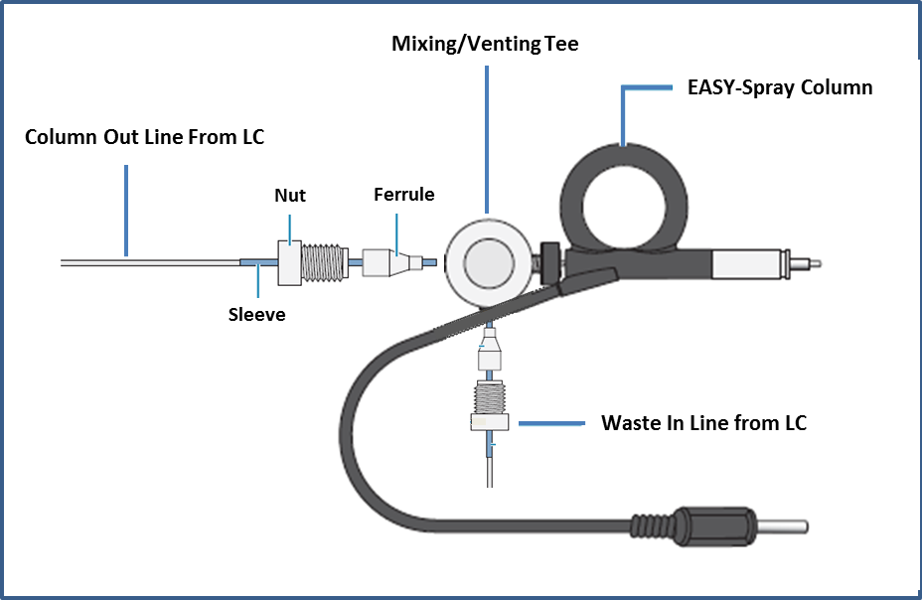
EASY-nLC II with EASY-Spray Column
Consumables
Schematic
Item | Image | Part number
A/B mixing & venting Tee |  | SC901
EASY-Spray column |  | ES800
Tubing Sleeve, 865 µm (0.034") ID x 1/16" OD, PEEK™, Blue |  | (IDEX) F233
Sleeve

Slide 15
EASY-nLC II with Liquid Junction, Precolumn, Analytical Column and Emitter
Consumables
Schematic
Item | Image | Part number
HPLC Liquid Junction Cross + Beige Sleeves |  | ES257
Red peek union for 1/32” OD |  | (IDEX) P-771
Sleeves for connecting OD 360 µm capillary to unions* | Beige (360µm x 1/32”)* | SC603*
Silica Emitter |  | FS360-20-10-N-20 (New Objective)
Waste In Line from LC
1/32” OD
Column Out to LC
1/32” OD
Liquid Junction Cross
Silica Emitter
*
*
*
*
*
Pre-
Column
Analytical
Column
Peek
Union
Peek
Union
HV

Slide 16
EASY-nLC II with Liquid Junction, Precolumn, and Packed Emitter
Consumables
Schematic
Item | Image | Part number
HPLC Liquid Junction Cross + Beige Sleeves |  | ES257
Red peek union for 1/32” OD |  | (IDEX) P-771
Sleeves for connecting OD 360 µm capillary to unions* | Beige (360µm x 1/32”)* | SC603*
Waste In from LC
1/32” OD
Column Out to LC
1/32” OD
Liquid Junction Cross
*
*
*
Pre-
Column
Peek
Union
Packed
Emitter
HV

Slide 17
EASY-nLC II with Liquid Junction, Analytical Column and Emitter
Consumables
Schematic
Item | Image | Part number
HPLC Liquid Junction Cross + Beige Sleeves |  | ES257
Red peek union for 1/32” OD |  | (IDEX) P-771
Sleeves for connecting OD 360 µm capillary to unions* | Beige (360µm x 1/32”)* | SC603*
Silica Emitter |  | FS360-20-10-N-20 (New Objective)
Waste In from LC
1/32” OD
Column Out to LC
1/32” OD
Silica Emitter
Liquid Junction Cross
*
*
*
Analytical
Column
Peek
Union
HV

Slide 18
EASY-nLC II with Liquid Junction and Packed Emitter
HPLC Schematic
Consumables
Item | Image | Part number
HPLC Liquid Junction Cross + Beige Sleeves |  | ES257
Sleeves for connecting OD 360 µm capillary to unions* | Beige (360µm x 1/32”)* | SC603*
Waste In from LC
1/32” OD
Column Out to LC
1/32” OD
Liquid Junction Cross
*
HV
Packed Emitter

Slide 19
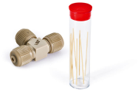
EASY-nLC II with Direct Junction, Precolumn, Analytical Column and Emitter
Consumables
Item | Image | Part number
Red peek union for 1/32” OD |  | (IDEX) P-771
Sleeves for connecting OD 360 µm capillary to unions* | Beige (360µm x 1/32”)* | SC603*
Venting Tee + Beige Sleeves |  | SC601
Metal Emitter |  | ES542
Schematic
Waste In from LC
1/32” OD
Column Out to LC
1/32” OD
Metal Emitter
Venting Tee
*
*
*
*
*
Pre-
Column
Analytical
Column
Peek
Union
Peek
Union

Slide 20
EASY-nLC II with Direct Junction, Analytical Column and Emitter
Consumables
Schematic
Item | Image | Part number
Red peek union for 1/32” OD |  | (IDEX) P-771
Sleeves for connecting OD 360 µm capillary to unions* | Beige (360µm x 1/32”)* | SC603*
Venting Tee + Beige Sleeves |  | SC601
Metal Emitter |  | ES542
Waste In from LC
1/32” OD
Column Out to LC
1/32” OD
Metal Emitter
Venting Tee
*
*
*
Analytical
Column
Peek
Union

Slide 21
RSLCnano with Precolumn and EASY-Spray Column
Consumables
Schematic
Item | Image | Part number
Ultimate 3000 RSLCnano EASY-Spray Connection Kit | See Slide 33 | 6720.0395
Viper Union |  | SC900
Acclaim Pepmap Pre-Column + µ-Precolumn holder |  | 160454 + 164649
EASY-Spray column |  | Various: ES801 ES802 ES803
Viper Union
Ultimate 3000 RSLCnano EASY-Spray Connection Kit
*Shortest length necessary to attach valve to EASY-Spray Column

Slide 22
RSLCnano with EASY-Spray Column
Schematic
Consumables
Item | Image | Part number
Ultimate 3000 RSLCnano EASY-Spray Connection Kit | See Slide 33 | 6720.0395
Viper Union |  | SC900
EASY-Spray column |  | Various: ES801 ES802 ES803
Viper Union
Auto
Sampler
Valve
*Shortest length necessary to attach valve to EASY-Spray Column
Ultimate 3000 RSLCnano EASY-Spray Connection Kit

Slide 23
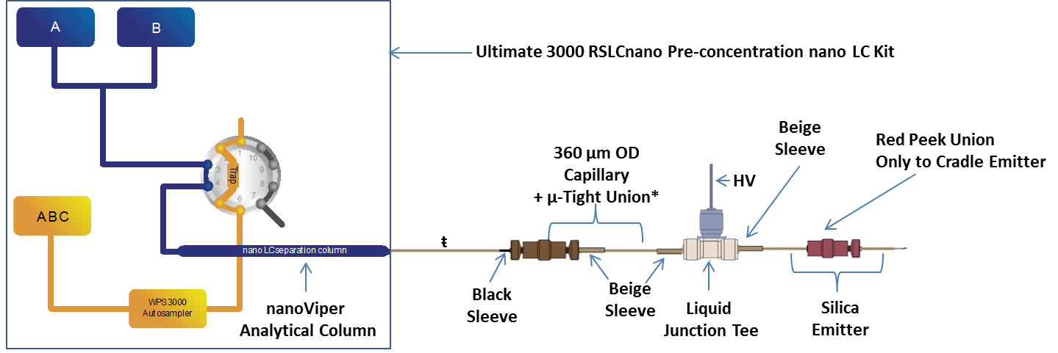
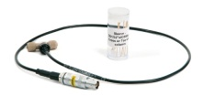
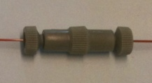
RSLCnano with Liquid Junction, Precolumn, Heated Analytical Column and Emitter
Item | Image | Part number
UltiMate 3000 RSLCnano Pre-concentration nano LC kit | Contents Slide 34 | 6720.0310
µ-Tight Union* |  | (IDEX) P-720*
Sleeves for Connecting Capillary to µ-Tight Union | Black (280µm x 1/32”) Beige (360µm x 1/32”) | SC903 SC603
Item | Image | Part number
HPLC Liquid Junction Tee + Biege Sleeves |  | ES258
Red peek union for 1/32” OD |  | (IDEX) P-771
Silica Emitter |  | FS360-20-10-N-20-C12 (New Objective)
*Only necessary if analytical column is not long enough to reach the liquid junction tee
^{ŧ} Note: This tubing has a 280 µm OD

Slide 24
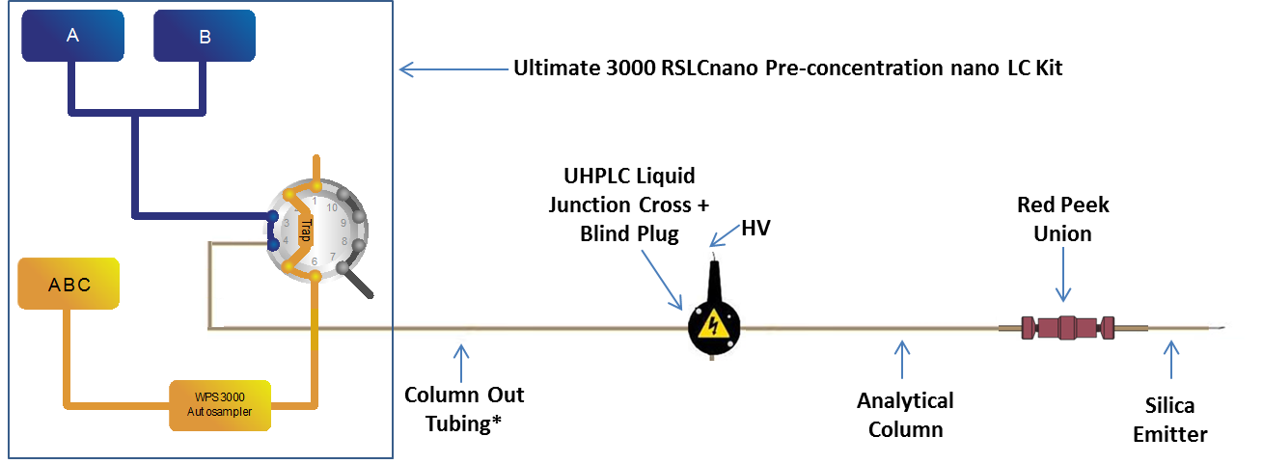

RSLCnano with Liquid Junction, Precolumn, Room Temperature Analytical Column and Emitter
Item | Image | Part number
UltiMate 3000 RSLCnano Pre-concentration nano LC kit | Contents Slide 34 | 6720.0310
Column Out Tubing* | Viper on LC side only* | 6041.5290*
UPLC Liquid Junction Cross Kit |  | ES269
Item | Image | Part number
UHPLC Blind Plug |  | (IDEX) P-116
Red peek union for 1/32” OD + Beige Sleeves | 360 µm x 1/32” | (IDEX) P-771 SC603
Silica Emitter |  | FS360-20-10-N-20 (New Objective)
*For non-Viper Column Connections

Slide 25
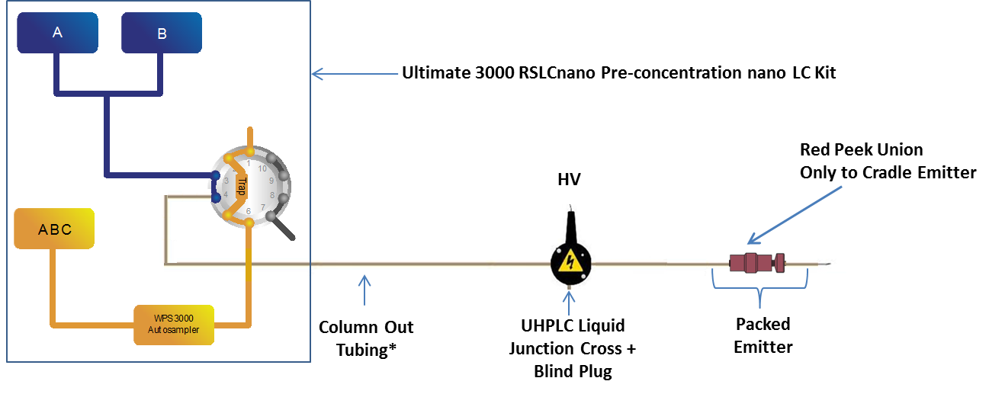
RSLCnano with Liquid Junction, Precolumn, and Packed Emitter
Item | Image | Part number
UltiMate 3000 RSLCnano Pre-concentration nano LC kit | Contents Slide 34 | 6720.0310
Column Out Tubing* | Viper on LC side only* | 6041.5290*
UPLC Liquid Junction Cross Kit |  | ES269
Item | Image | Part number
UHPLC Blind Plug |  | (IDEX) P-116
Red peek union for 1/32” OD |  | (IDEX) P-771
*For non-Viper Column Connections

Slide 26
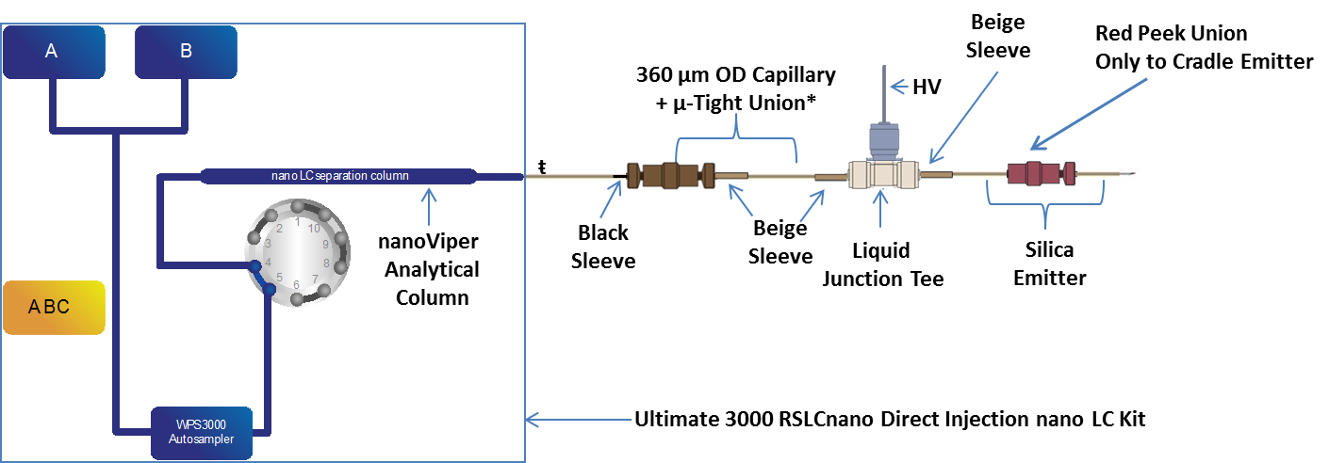
RSLCnano with Liquid Junction Heated Analytical Column and Emitter
Item | Image | Part number
UltiMate 3000 RSLCnano Direct Injection nano LC kit | Contents Slide 34 | 6720.0300
µ-Tight Union* |  | (IDEX) P-720*
Sleeves for Connecting Capillary to µ-Tight Union | Black (280µm x 1/32”) Beige (360µm x 1/32”) | SC903 SC603
Item | Image | Part number
HPLC Liquid Junction Tee + Biege Sleeves |  | ES258
Red peek union for 1/32” OD |  | (IDEX) P-771
Silica Emitter |  | FS360-20-10-N-20-C12 (New Objective)
*Only necessary if analytical column is not long enough to reach the liquid junction tee
^{ŧ} Note: This tubing has a 280 µm OD

Slide 27
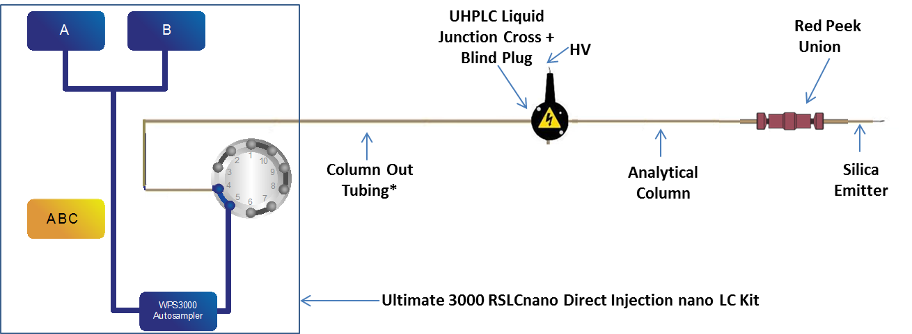
RSLCnano with Liquid Junction Room Temperature Analytical Column and Emitter
Item | Image | Part number
UltiMate 3000 RSLCnano Direct Injection nano LC kit | Contents Slide 35 | 6720.0300
Column Out Tubing* | Viper on LC side only* | 6041.5290*
UPLC Liquid Junction Cross Kit |  | ES269
Item | Image | Part number
UHPLC Blind Plug |  | (IDEX) P-116
Red peek union for 1/32” OD + Beige Sleeves | 360 µm x 1/32” | (IDEX) P-771 SC603
Silica Emitter |  | FS360-20-10-N-20 (New Objective)
*For non-Viper Column Connections

Slide 28
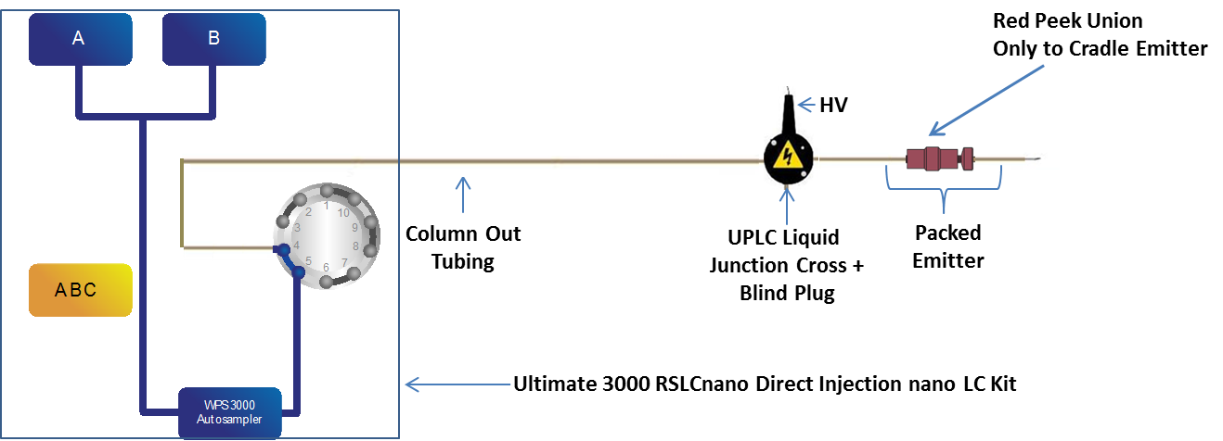
RSLCnano with Liquid Junction and Packed Emitter
Item | Image | Part number
UltiMate 3000 RSLCnano Direct Injection nano LC kit | Contents Slide 35 | 6720.0300
Column Out Tubing | Viper on LC side only | 6041.5290*
UPLC Liquid Junction Cross Kit |  | ES269
Item | Image | Part number
UHPLC Blind Plug |  | (IDEX) P-116
Red peek union for 1/32” OD |  | (IDEX) P-771

Slide 29
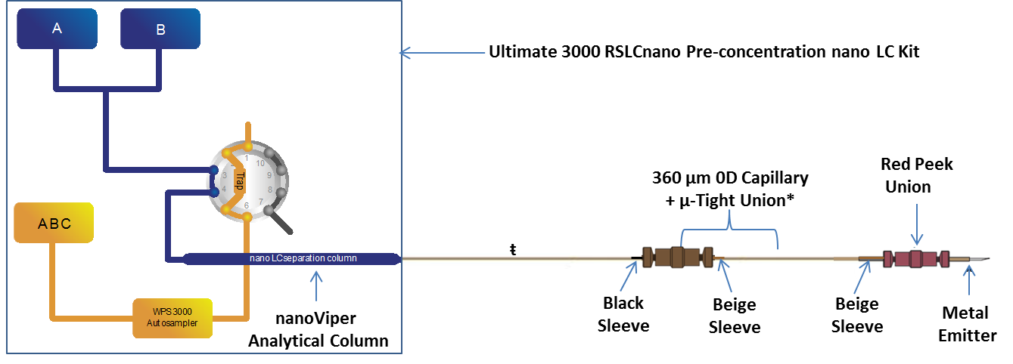
RSLCnano with Direct Junction, Precolumn, Heated Analytical Column and Emitter
Item | Image | Part number
UltiMate 3000 RSLCnano Pre-concentration nano LC kit | Contents Slide 34 | 6720.0310
µ-Tight Union* |  | (IDEX) P-720*
Sleeves for Connecting Capillary to unions | Black (280µm x 1/32”) Beige (360µm x 1/32”)* | SC903 SC603
Item | Image | Part number
Red peek union for 1/32” OD |  | (IDEX) P-771
Metal Emitter |  | E542
*Only necessary if analytical column is not long enough to reach the liquid junction tee
^{ŧ} Note: This tubing has a 280 µm OD

Slide 30
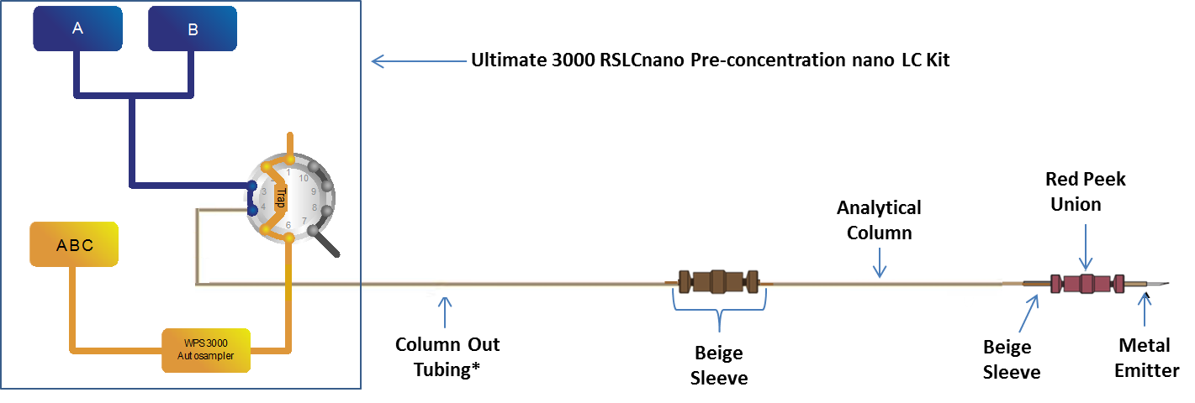
RSLCnano with Direct Junction, Precolumn, Room Temperature Analytical Column and Emitter
Item | Image | Part number
UltiMate 3000 RSLCnano Pre-concentration nano LC kit | Contents Slide 34 | 6720.0310
Column Out Tubing* | Viper on LC side only* | 6041.5290*
µ-Tight Union |  | (IDEX) P-720
Item | Image | Part number
Red peek union for 1/32” OD + Beige Sleeves | Beige (360µm x 1/32”) | (IDEX) P-771 SC603
Metal Emitter |  | ES542
*For non-Viper Column Connections

Slide 31
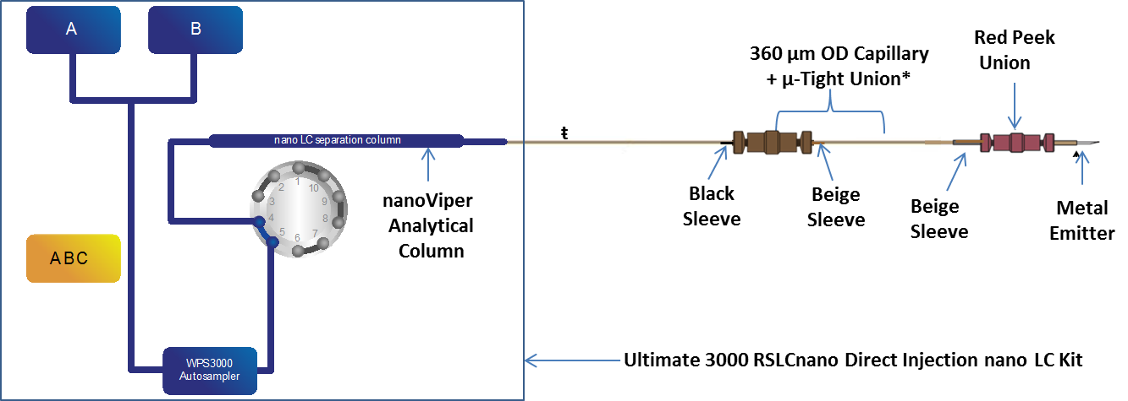
RSLCnano with Direct Junction Heated Analytical Column and Emitter
Item | Image | Part number
UltiMate 3000 RSLCnano Direct Injection nano LC kit | Contents Slide 35 | 6720.0300
µ-Tight Union* |  | (IDEX) P-720*
Sleeves for Connecting Capillary to µ-Tight Union | Black (280µm x 1/32”) Beige (360µm x 1/32”) | SC903 SC603
Item | Image | Part number
Red peek union for 1/32” OD |  | (IDEX) P-771
Sleeve for connecting to red peek union | Beige (360µm x 1/32”)* | SC603
Metal Emitter |  | ES542
*Only necessary if analytical column is not long enough to reach the liquid junction tee
^{ŧ} Note: This tubing has a 280 µm OD

Slide 32
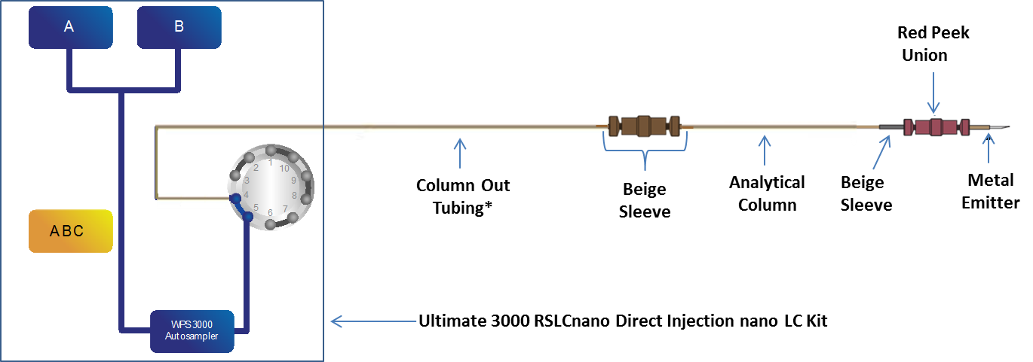
RSLCnano with Direct Junction Room Temperature Analytical Column and Emitter
Item | Image | Part number
UltiMate 3000 RSLCnano Direct Injection nano LC kit | Contents Slide 35 | 6720.0300
Column Out Tubing* | Viper on LC side only | 6041.5290*
µ-Tight Union |  | (IDEX) P-720
Item | Image | Part number
Red peek union for 1/32” OD |  | (IDEX) P-771
Sleeves for Connecting to Unions | Beige (360µm x 1/32”) | SC603
Metal Emitter |  | ES542
*For non-Viper Column Connections

Slide 33
UltiMate 3000 RSLCnano EASY-Spray Connection Kit
UltiMate 3000 RSLCnano EASY-Spray connection kit | 6720.0395
Item | Replacement P/N
300 µm I.D. x 5 mm, packed with Acclaim PepMap100 C18, 5 µm, 100Å (set of 5 cartridges)* | 160454*
µ-Precolumn holder, 5 mm, with 30 µm I.D. connecting tubing, nanoViper fittings* | 164649*
nanoViper Capillary FS/PEEK sheathed 1/32" I.D. x L 20 µm x 350 mm | 6041.5240
nanoViper Capillary FS/PEEK sheathed 1/32" I.D. x L 20 µm x 550 mm | 6041.5260
nanoViper Capillary FS/PEEK sheathed 1/32" I.D. x L 20 µm x 650 mm | 6041.5275
nanoViper Capillary FS/PEEK sheathed 1/32" I.D. x L 20 µm x 750 mm | 6041.5280
nanoViper Capillary FS/PEEK sheathed 1/32" I.D. x L 75 µm x 550 mm | 6041.5760
nanoViper Capillary FS/PEEK sheathed 1/32" I.D. x L 75 µm x 650 mm | 6041.5775
nanoViper Sample Loop 20 µL, FS/PEEK sheathed | 6826.2420
Union Viper | 2261.5061
PTFE tubing, 500 µm I.D. x 100 cm, used as waste tubing | 6720.0077
1/16" Universal Fingertight Fitting, one-piece design, extra long thread, 4 pieces | 6720.0015
Polypropylene vials for WPS with glass insert, 250 µL, 25 pieces | 6820.0027
Polypropylene caps for WPS vials, 25 pieces | 6820.0028
Cytochrome C digest, 1.6 nmol, Lyophilized | 161089
*For Pre-concentration Set Up Only

Slide 34
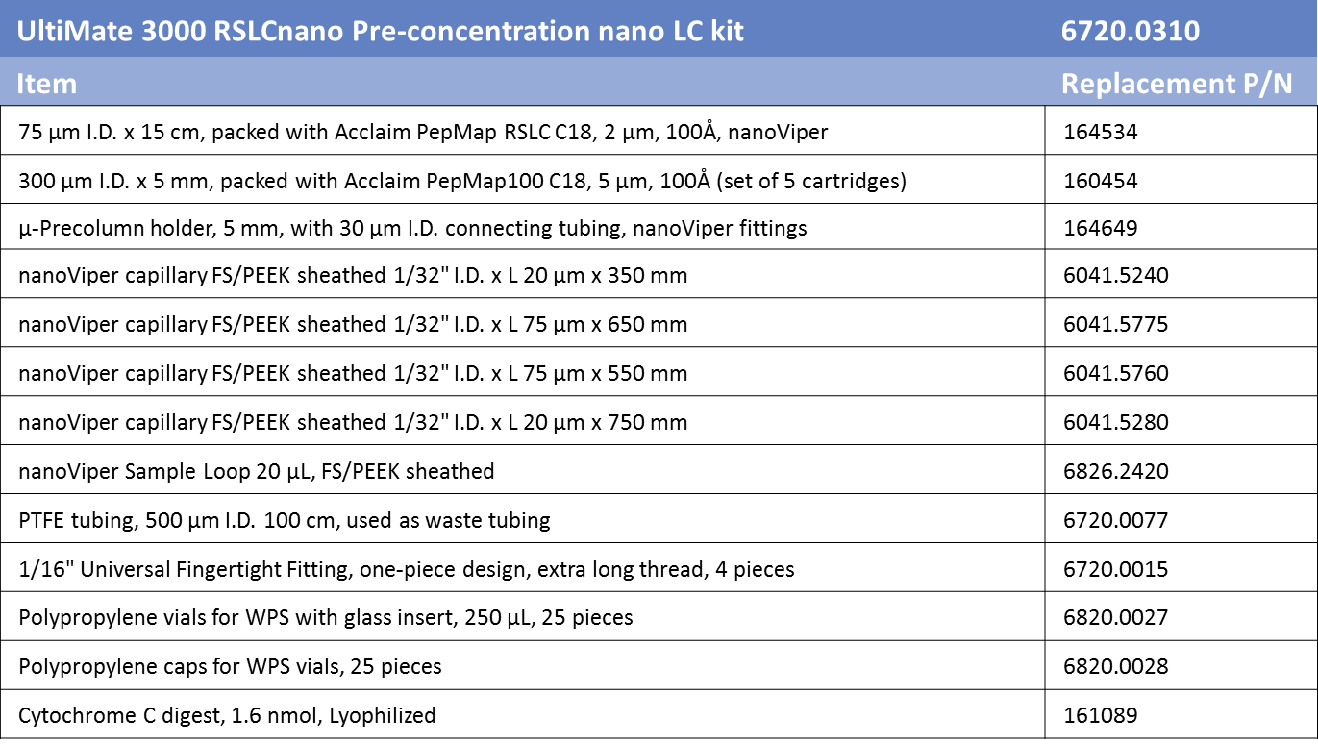
UltiMate 3000 RSLCnano Pre-concentration nano LC Kit

Slide 35
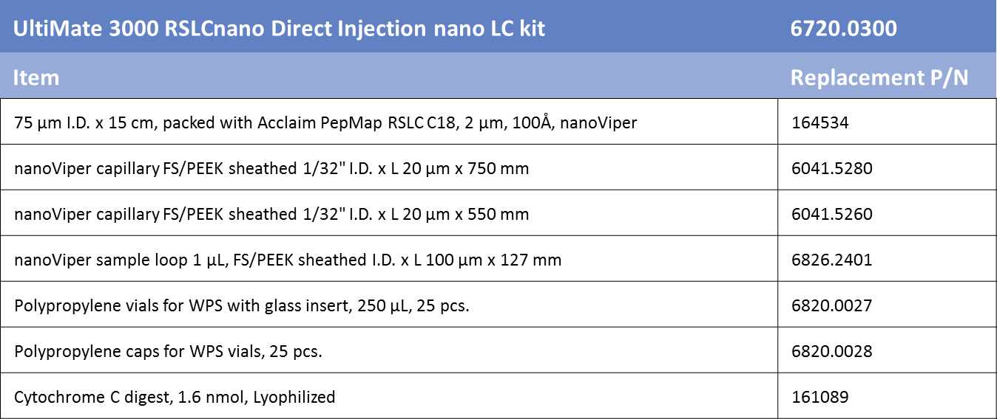
UltiMate 3000 RSLCnano Direct Injection nano LC Kit

Slide 36
How to Guideline
Making Viper Connections— Slide 37
Making Connections with Sleeves— Slide 38
Limit Pressure on EASY nLC Systems— Slide 39
Limit Pressure on RSLCnano— Slide 40
How Frequently Should I Replace My Unions and Sleeves?— Slide 41

Slide 37
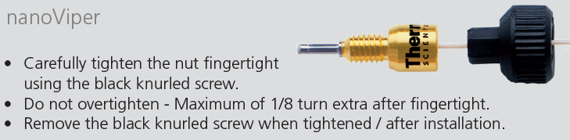
Making Viper Connections

Slide 38
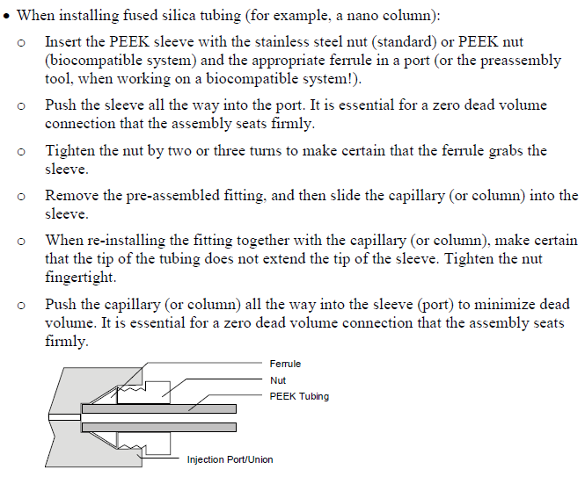
Making Connections With Sleeves

Slide 39
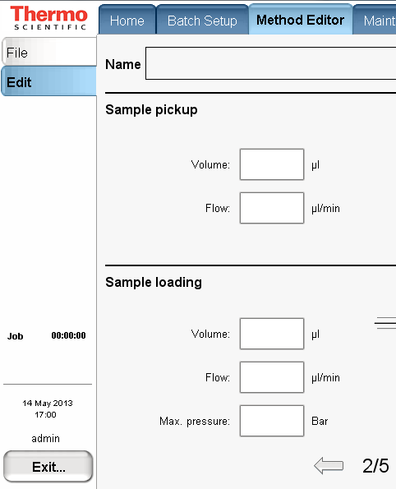
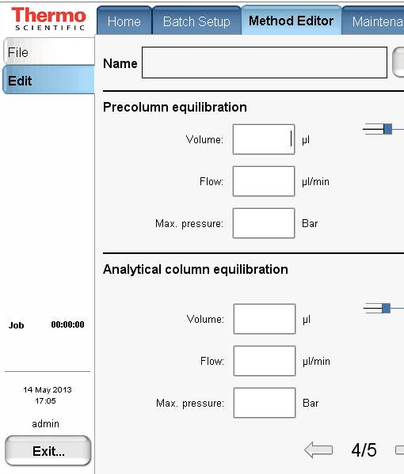
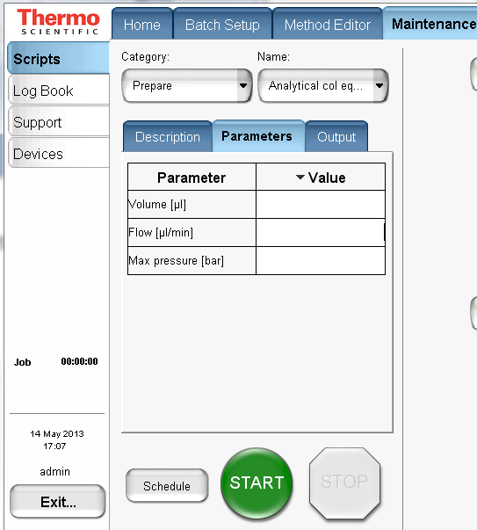
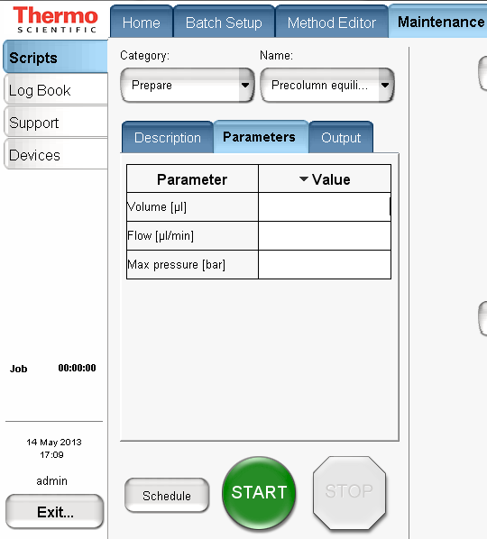
To limit the EASY-nLC 1000 to 300 bars when running with a column setup rated to max 300 bar please change the Max pressure setting to 300 bar in: -Methods; for Sample loading and Analytical and Precolumn equilibration -Scripts; for Analytical and Precolumn equilibration Choose only flows for gradient, isocratic flow and idle flow that will create less than 300 bar on your column setup.
Limiting Pressure on EASY nLC Systems

Slide 40
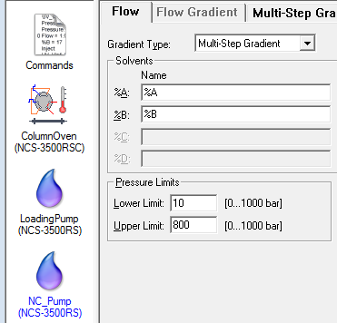
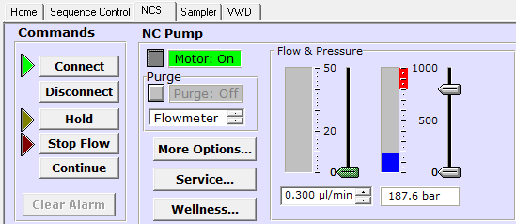
Limiting the Pressure on RSLCnano systems
The RSLCnano has an upper and lower pressure limit
The pressure limit can be set in each instrument method
NC_Pump icon on the flow tab
Or directly on the control panel, using the sliders
Upper limit
Lower limit

Slide 41
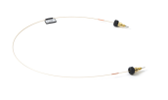
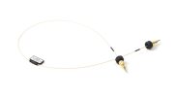
How Frequently Should I Replace My Unions and Sleeves?
Item | Image | Part number | Keep on hand | When to replace
Red peek union for 1/32” OD |  | (IDEX) P-771 | 10 | No more than two connections
µ-Tight Union |  | (IDEX) P-720 | 10 | No more than two connections
Sleeves for connecting OD 280 µm capillary to unions | Black (280µm x 1/32”) | SC903 | 20 | Every time you make a new connection
Sleeves for connecting OD 360 µm capillary to unions | Beige (360µm x 1/32”) | SC603 | 20 | Every time you make a new connection
Column Out Tubing Waste In Tubing | Viper on LC side only Viper on LC side only | 6041.5290 6041.5289 | 2 2 | Whenever viper is damage, silica is too short, or line is clogged
Column Out Flow Line Waste In Flow Line | Column Waste | LC560 LC562 | 1 1 | When Viper is damaged or line is clogged
Viper Union |  | SC900 | 2 | Good to have on hand for EASY nanoLC Leak Tests
Ultimate 3000 RSLCnano EASY-Spray Connection Kit | Contents Slide 33 | 6720.0395 | 1 | When tubing clogs or column fails
UltiMate 3000 RSLCnano Pre-concentration nano LC kit | Contents Slide 34 | 6720.0310 | 1 | When tubing clogs or column fails
UltiMate 3000 RSLCnano Direct Injection nano LC kit | Contents Slide 35 | 6720.0300 | 1 | When tubing clogs or column fails

